Slide 1
STENOGRAPHY IN PYTHON
CAPSTONE PROJECT
Presented By:
Student Name : Akshaj Deepak
College Name & Department : SRM Institute of Science and Technology
Btech CSE Core, Ctech Department

Slide 2
OUTLINE
Problem Statement
Technology used
Wow factor
End users
Result
Conclusion
Git-hub Link
Future scope

Slide 3
Problem Statement
The challenge is to securely conceal sensitive data within an image using steganography, ensuring confidentiality while preventing unauthorized access. Unlike traditional encryption, which can make hidden data detectable, steganography seamlessly integrates information into image pixels without visibly altering the image. The goal is to design an efficient algorithm that embeds and extracts data while preserving both image quality and security.

Slide 4
Technology used
Language Used: Python
Libraries Used:’
Standard Libraries: NumPy, OpenCV, OS, Tkinter, string
Platforms:
Operating System: Windows 11
IDE: JetBrains PyCharm
File Format: BMP (Bitmap Image), JPEG
Additional Points:
Steganography Method: Least Significant Bit (LSB) Encoding
Data Handling: Embeds and extracts text data from images
Ability to upload image directly from the file manager without having to specify the path.

Slide 5
Wow factors
Seamless Image-Based Encryption: 🔐 Hides secret messages directly within image pixels, making the data nearly undetectable to unauthorized users.
Minimal Image Distortion: 🖼 Embeds text without visibly altering the image, ensuring that the encrypted image looks just like the original.
Dual-Layer Security with Passcode Protection: 🔑 Even if someone extracts the modified image, they still need the correct passcode to decrypt the hidden message.
Simple Yet Effective Algorithm: ⚡ Uses a lightweight pixel-mapping technique for encoding, ensuring fast encryption and decryption.
User-Friendly File Selection: 📂 Uses a GUI-based file dialog to let users easily pick an image for encryption.
Cross-Format Compatibility: 🌐 Supports multiple image formats (JPEG, PNG, BMP), making it versatile for different use cases.
Automatic Image Opening After Encryption: 🖥 Instantly opens the encrypted image, allowing users to verify that their file remains visually unchanged.
Platform-Agnostic Execution: 🏆 Works on different OS platforms with minor modifications (e.g., replacing os.system("start...") for macOS/Linux).

Slide 6
End users
End Users:
Journalists & Whistleblowers 📰🔍
Can securely hide sensitive information within images to avoid detection while sharing critical reports or evidence.
Cybersecurity Professionals 💻
Useful for training and research in digital forensics, data protection, and steganalysis techniques.
Government & Intelligence Agencies 🏛
Can be used for covert communication and classified data transmission without raising suspicion.
Businesses & Corporations 📊💼
Helps protect confidential business documents or trade secrets by embedding them within images.
Privacy-Conscious Individuals 🕶
Allows everyday users to store personal notes, passwords, or private messages hidden inside images.
Artists & Digital Creators 🎨
Can embed hidden signatures or copyrights within their artwork to prevent plagiarism and prove authenticity.
Researchers & Academics 🔬
Useful for studying data-hiding techniques, cryptography, and information security in educational settings.
Hackathon Participants & Developers 🚀
Can serve as a foundation for innovative security applications in hackathons or cybersecurity competitions.

Slide 7
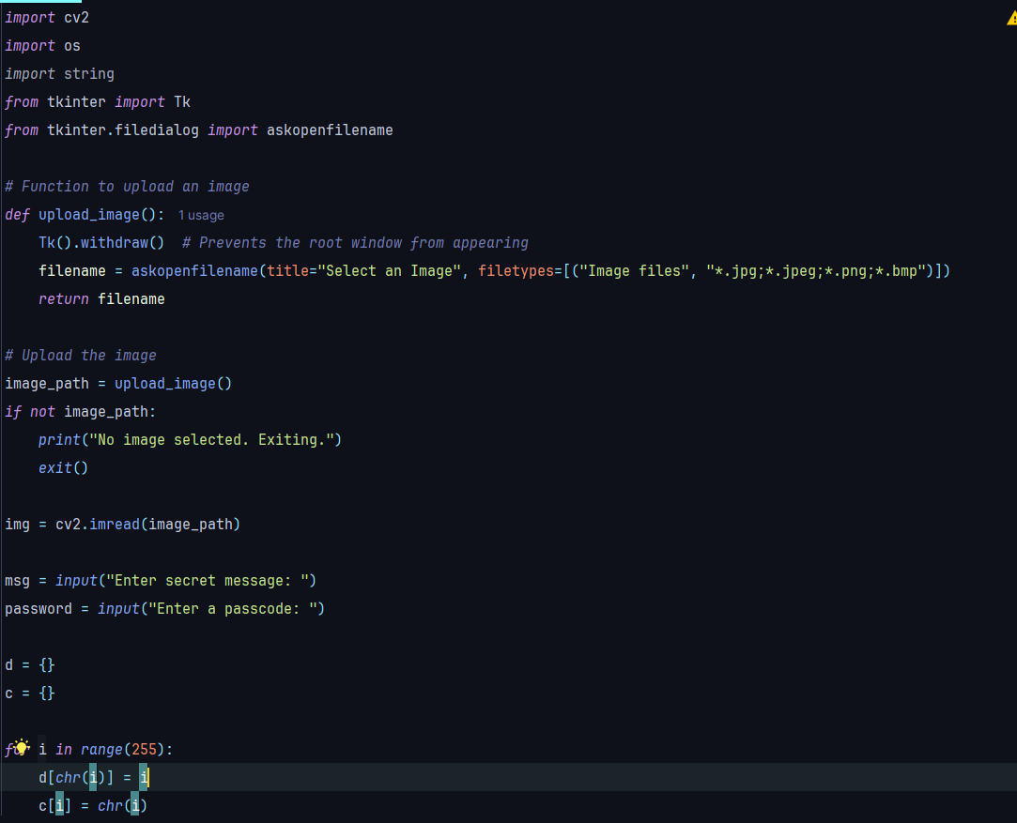
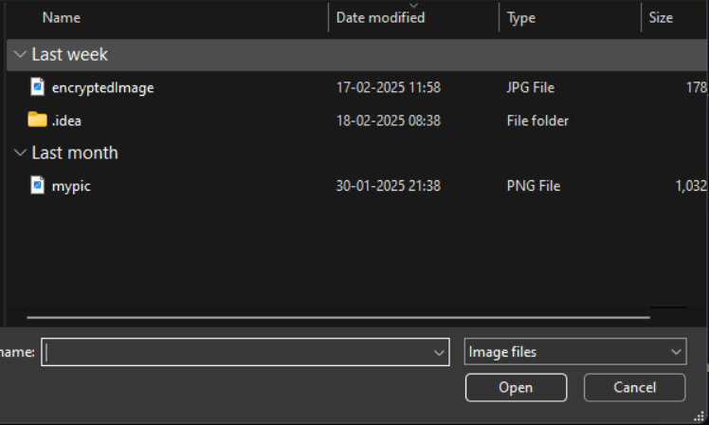
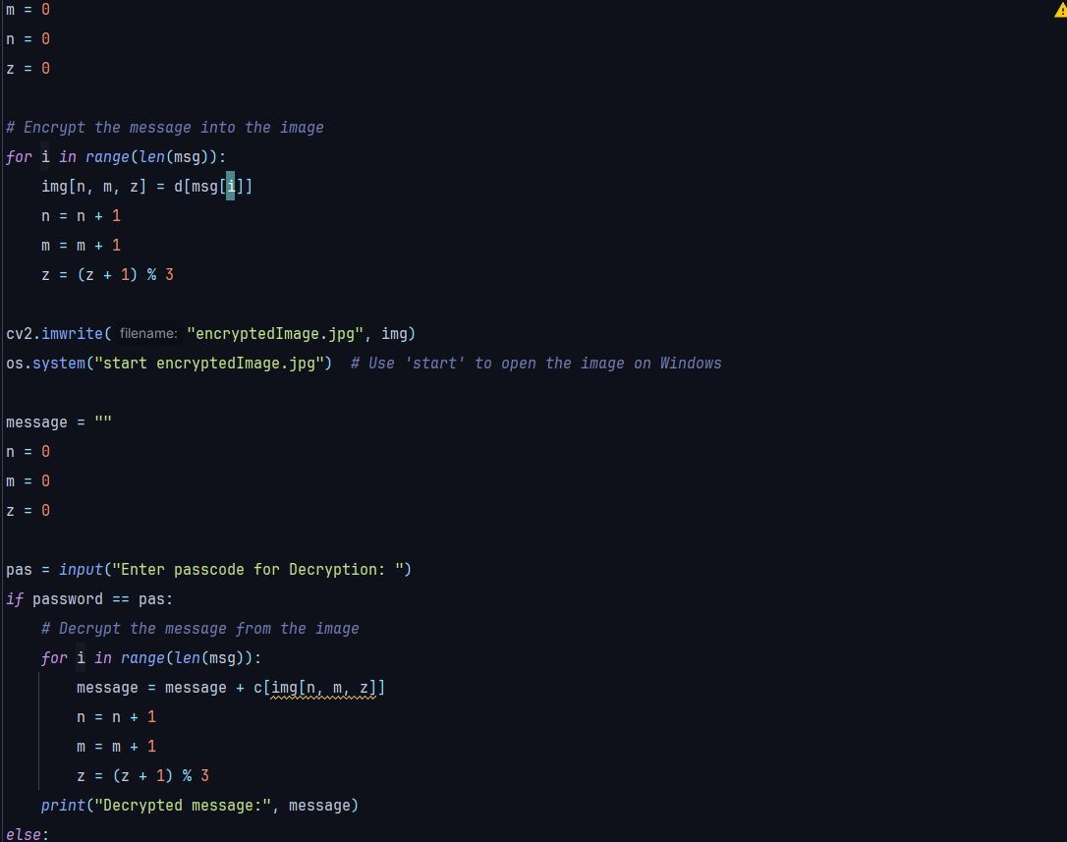
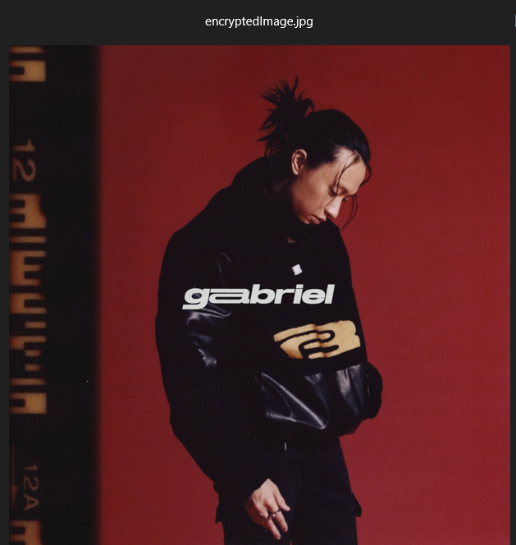


Results

Slide 8
Conclusion
This steganography-based image encryption system provides a simple yet powerful way to conceal sensitive information within images while maintaining their visual integrity. By embedding text within pixel values and securing access with a passcode, the code ensures an additional layer of security, making it useful for confidential communication and data protection.
With its ease of use, cross-format compatibility, and seamless encryption-decryption process, this program has applications in cybersecurity, journalism, corporate security, and personal privacy. While effective for basic steganography, future enhancements such as improved encryption algorithms, increased storage efficiency, and AI-based steganalysis resistance could further strengthen its security.
Would you like any refinements, such as adding stronger encryption or a more efficient encoding technique? 🚀

Slide 9
GitHub Link
https://github.com/AstralJay/stenography

Slide 10
Future scope(optional)
Enhanced Security with Stronger Encryption 🔐
Integrate AES or RSA encryption alongside steganography to add multiple layers of security.
Advanced Image Processing Techniques 🖼
Utilize LSB (Least Significant Bit) substitution with random pixel selection to make detection even harder.
Increased Data Capacity 📊
Implement more efficient encoding methods, such as DCT (Discrete Cosine Transform) or Wavelet Transformation, to store larger messages without noticeable distortion.
Multi-Format Support & Compression Handling 📂
Expand compatibility to include GIFs and videos, and develop methods to prevent data loss due to image compression.
Steganalysis Resistance 🛡
Develop AI-powered algorithms to counteract steganalysis techniques that detect hidden messages.
Real-Time Communication Integration 📡
Extend functionality to messaging apps, allowing secure exchange of encrypted images via email or chat applications.
Blockchain Integration for Authentication ⛓
Implement blockchain to verify the authenticity of steganographic messages, ensuring tamper-proof data transmission.

Slide 11
THANK YOU

